Slide 1
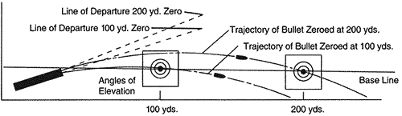
300m
100m
200m
1”
2”
3”
Minute of Angle – M.O.A. or Moh Ah
  Derived from imperial measurements of Degrees, Minutes, Seconds of angle (rather than Mils)
  Angle of uncertainty between point of aim and point of impact
  Results in a “grouping” of impacts
  C7 capable of 1 MOA which is approximately 1” at 100yards (close enough to 1” at 100m)
  Angle of uncertainty is consistent at all distances. Factors such as wind and bullet drop have minimal effect on “grouping” size
  Gauge of Precision
Distance (m) | Drop in Inches | # Clicks adjustment (from 100m Zero)
100 | 0 | 0
200 | 2 | 1
300 | 9 | 3
400 | 24 | 6
500 | 50 | 10
C7 with Military ammo (62gr ss109 bullet)
  Bullet drop increases significantly over distance
  Specific adjustment may change based on shooter and rifle
  Elevation also needs to be adjusted based on barometric pressure
    Generally follows the rule of “Sun’s Up Sights Up” adding 1 extra click of elevation on sunny warm days

Slide 2
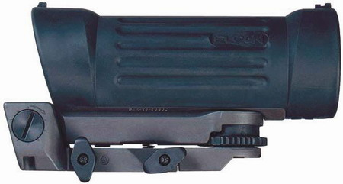
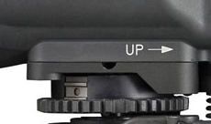
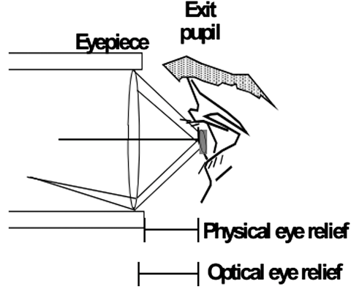


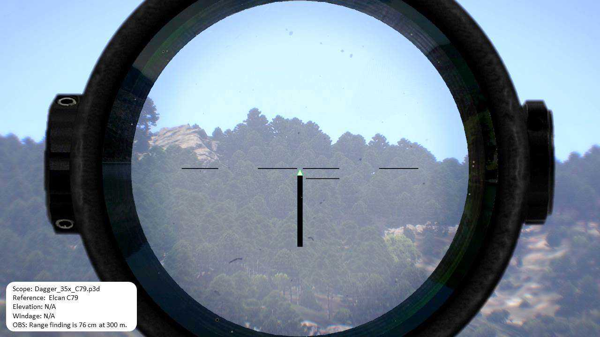
Windage
Requires a Quarter or similar washer to adjust!
Arrow points in direction to adjust to RIGHT
Elevation
Two disks:
1. Pre defined distances (rough estimates)
2. Zero disk with fine adjustment to set the Sight zero
Unlike Windage disk, UP has an indicated direction
Disk Lock
“gate” should be up to adjust the Fine disk independently from the pre set disk
  Mounting Screws
  Uses Mil Std 1913 mount
  Keep Tight!
C-79 Sight - each “click” is approx. 1” at 100m (technically, .85MOA)
3.7x magnification
Reticle has a 70mm Eye Relief so sight needs to have its position on the C7 adjusted based on shooter’s ergonomics
Incorrect eye position will result in PARALLAX
Parallax is the difference between perceived POA and POI
Zero Parallax means POA and POI are the same
Point of Aim – POA – The place on a target you want to hit
Point of Impact – POI – The place on a target you actually hit
Good Eye Relief
Poor Eye Relief
  Zero Parallax
  Consistent shots
  Good PRECISION
  Parallax
  Will shift between shots
  Inconsistent -Poor PRECISION

Slide 3
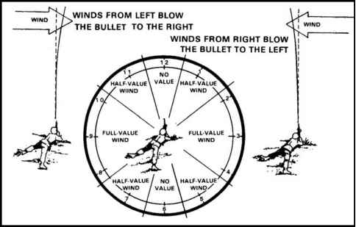
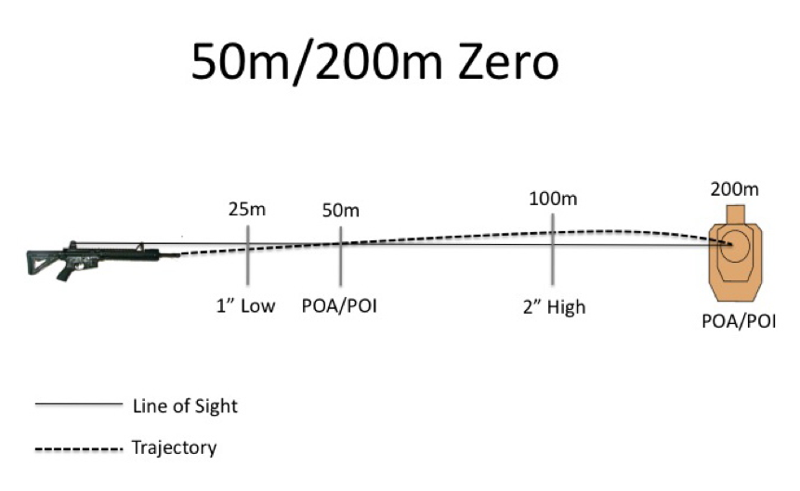
Windage
Wind has minimal effect from 0-100m, each subsequent 100m has greater effect assuming constant wind
  1. Gauge Wind Speed
2. Find Drift for speed at distance
  3. Multiply Drift by ratio based on Direction
Speed (kph) | Description
<1 | Smoke rises vertically
2-5 | Direction of wind shown by smoke drift
6-11 | Wind felt on face
12-19 | Wind extends light flag
20-29 | Raises dust and loose paper
30-38 | Small trees in leaf begin to sway
39-50 | Large branches in motion
51-60 | Whole trees in motion; inconvenience felt in walking against wind
61-70 | Slight structural damage
71-85 | Trees uprooted
  4. Apply windage to Sight
Wind Drift in INCHES
 | Range in metres
Speed (kph) | 200 | 300 | 400 | 500
5 | 2/1 | 4/1 | 8/2 | 14/3
10 | 3/1 | 8/2 | 15/4 | 26/5
15 | 5/2 | 12/4 | 22/5 | 38/8
20 | 6/3 | 15/5 | 29/7 | 50/10
25 | 8/4 | 19/6 | 37/9 | 62/12
30 | 10/5 | 23/8 | 44/11 | 74/15
0
  Remember: Wind is usually referred to by direction it is coming FROM. Adjust windage to SAME direction.
  IE: Wind is coming from the LEFT, adjust sights to the LEFT
0.5
0.5
1
1
0.5
0
0.5
At ranges closer than 100m, the distance between the center of the rifle bore and the center of the sight affects Accuracy
Adjust elevation to longer distances to compensate

Slide 4
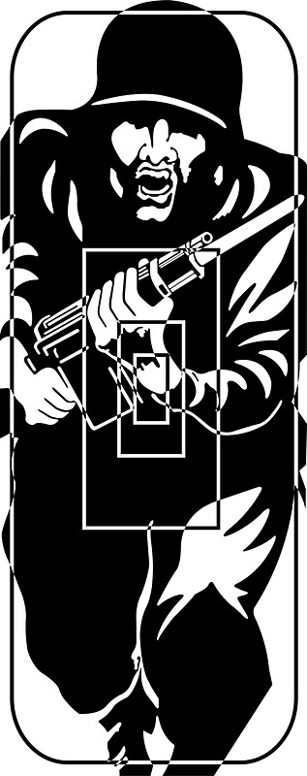

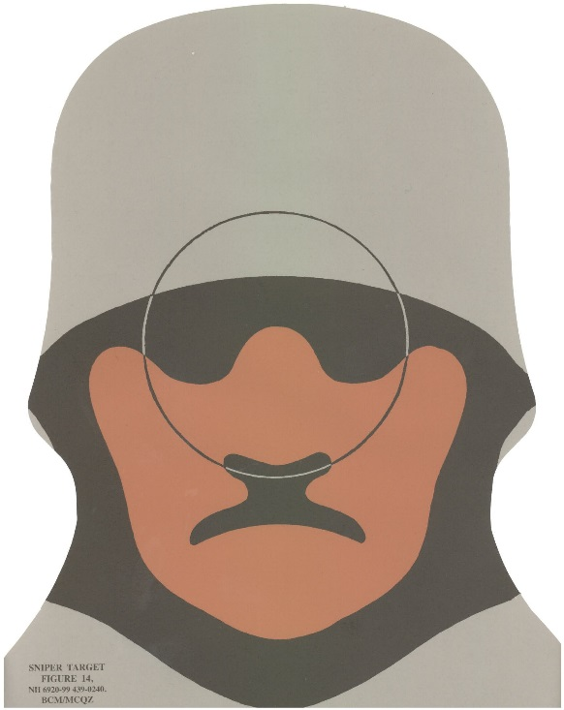
  Target moving LEFT
  Target moving RIGHT
  100m
  100m
  50m
  50m
  Target moving LEFT
  Target moving RIGHT
  Target moving LEFT
  Target moving RIGHT
  300m
  300m
  200m
  200m
Knowledge
  CAFSAC range instructions, words of command are minimalist
  Each competitor is obliged to know each stage of each match ahead of time
  Only instruction: “Match X, Load, Ready. Watch and Shoot”
  Mental Mantra prior to each stage:
    Sights, Safety, Wind, Prepare to move
  Sights – Adjust elevation for next stage
  Safety – Magazine for next stage loaded, readied, safety ON
  Wind – Take the opportunity to check wind, adjust windage before next stage
  Prepare to move – Go from a shooting stance to similar prep stance (ie from a tight kneel to high kneel) and trail arms

Slide 5
Distance (m) | Drop in Inches | # Clicks adjustment (from 100m Zero)
100 | 0 | 0
200 | 2 | 1
300 | 9 | 3
400 | 24 | 6
500 | 50 | 10
2. Find Drift for speed at distance
Wind Drift in INCHES
 | Range in metres
Speed (kph) | 200 | 300 | 400 | 500
5 | 2/1 | 4/1 | 8/2 | 14/3
10 | 3/1 | 8/2 | 15/4 | 26/5
15 | 5/2 | 12/4 | 22/6 | 38/8
20 | 6/3 | 15/5 | 29/7 | 50/10
25 | 8/4 | 19/6 | 37/9 | 62/12
30 | 10/5 | 23/8 | 44/11 | 74/15
  1. Gauge Wind Speed
Speed (kph) | Description
<1 | Smoke rises vertically
2-5 | Direction of wind shown by smoke drift
6-11 | Wind felt on face
12-19 | Wind extends light flag
20-29 | Raises dust and loose paper
30-38 | Small trees in leaf begin to sway
39-50 | Large branches in motion
51-60 | Whole trees in motion; inconvenience felt in walking against wind
61-70 | Slight structural damage
71-85 | Trees uprooted
  3. Multiply Drift by ratio based on Direction
0.5
0
0.5
1
1
0.5
0
0.5
  4. Apply windage to Sight
  Remember: Wind is usually referred to by direction it is coming FROM. Adjust windage to SAME direction.
  IE: Wind is coming from the LEFT, adjust sights to the LEFT

Slide 6
Distance (m) | Drop in Inches | # Clicks
100 | 0 | 0
200 | 2 | 1
300 | 9 | 3
400 | 24 | 6
500 | 50 | 10
Wind Drift in INCHES
Spd (kph) | Range in metres
 | 200 | 300 | 400 | 500
5 | 1 | 1 | 2 | 3
10 | 1 | 2 | 4 | 5
15 | 2 | 4 | 6 | 8
20 | 3 | 5 | 7 | 10
25 | 4 | 6 | 9 | 12
30 | 5 | 8 | 11 | 15
Spd (kph) | Description
<1 | Smoke rises vertically
2-5 | Direction shown by smoke drift
6-11 | Wind felt on face
12-19 | Wind extends light flag
20-29 | Raises dust and loose paper
30-38 | Small trees in leaf sway
39-50 | Large branches in motion
51-60 | Whole trees in motion
61-70 | Slight structural damage
71-85 | Trees uprooted
0.5
0
0.5
1
1
0.5
0
0.5
Wind Drift in INCHES
Spd (kph) | Range in metres
 | 200 | 300 | 400 | 500
5 | 1 | 1 | 2 | 3
10 | 1 | 2 | 4 | 5
15 | 2 | 4 | 6 | 8
20 | 3 | 5 | 7 | 10
25 | 4 | 6 | 9 | 12
30 | 5 | 8 | 11 | 15
0
Dist | Drop | #Clicks
100 | 0 | 0
200 | 2 | 1
300 | 9 | 3
400 | 24 | 6
500 | 50 | 10
kph | Description
<1 | Vertical smoke
2-5 | smoke drift
6-11 | Wind felt
12-19 | Flag extends
20-29 | Raises dust
30-38 | Small trees sway
.5
.5
1
1
.5
0
.5

